Slide 1
Exoplanet Classification using Data Mining
Mohit Doshi
Mentors: Dr. Huan Liu, Kaize Ding
School of Computing, Informatics and Decision Systems Engineering
Arizona State University
Arizona Space Grant 2021 Statewide Symposium
04/17/2021

Slide 2

Introduction
Exoplanets are planets which orbit a star outside of the Solar system
Earth – only known planet with verified presence of life
Habitable Planet – One that can sustain life for a significant period of time
Objective – Classify exoplanets on the basis of their potential for habitability
Data Mining – The process of extracting and discovering patterns in large data sets involving Machine Learning and Statistical Methods
Via EarthSky
Notes:
~ 1 min

Slide 3
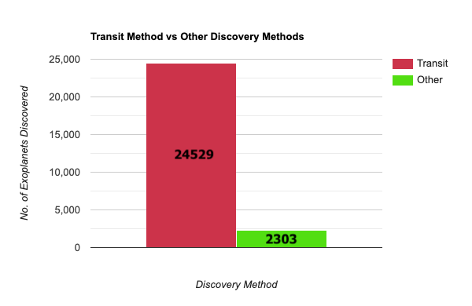
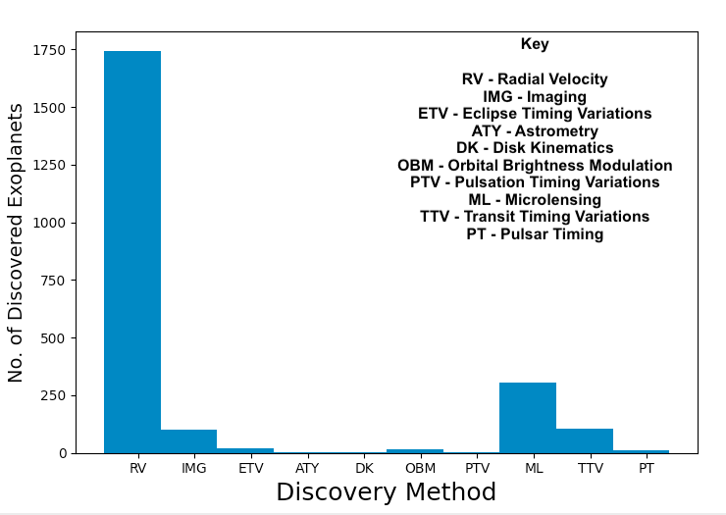
Data and Approach
Caltech Exoplanet Archive^{[1]} – 26382 exoplanets and 300+ columns – imported as CSV
87.3% of all exoplanets discovered using the Kepler Telescope and the Transit method of detection
Dataset: Huge and Sparse; many missing fields
Identify suitable features for constructing a model – 11 features identified
Selected 5 features: Orbital Period, Earth Radius, Equilibrium Temperature, Stellar Effective Temperature, and Stellar Radius
Training Data: 52 classified habitable and 1294 classified non-habitable from a 2017 study^{[2]}
Test Data: 1505 planets from Exoplanet Archive (not incl. training data) and corresponding feature sets
Python for Development (numpy, matplotlib, scikit-learn, pandas) and Machine Learning Analysis
Exoplanets discovered by Transit Method vs Other Methods
Exoplanet Discovery Methods
Figure 1.1: Exoplanets discovered by Transit Method vs Other Methods

Slide 4
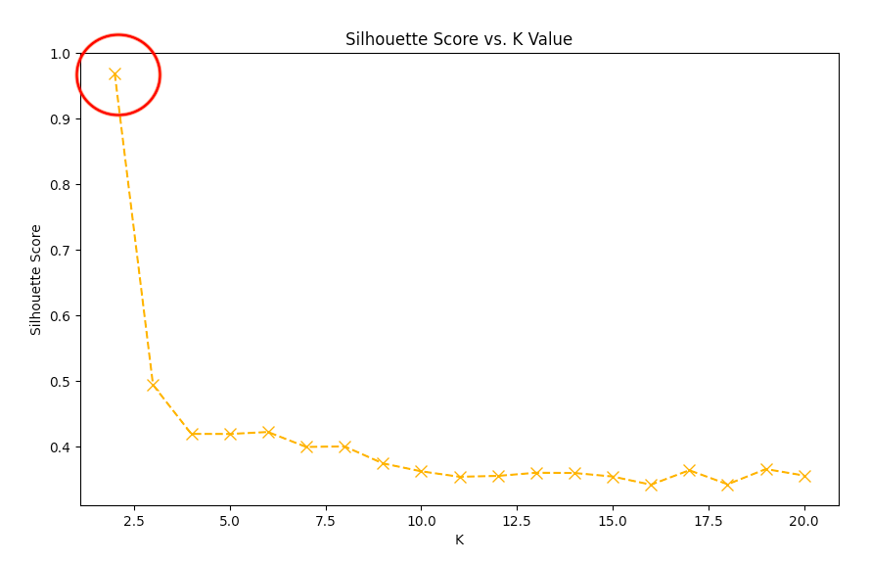
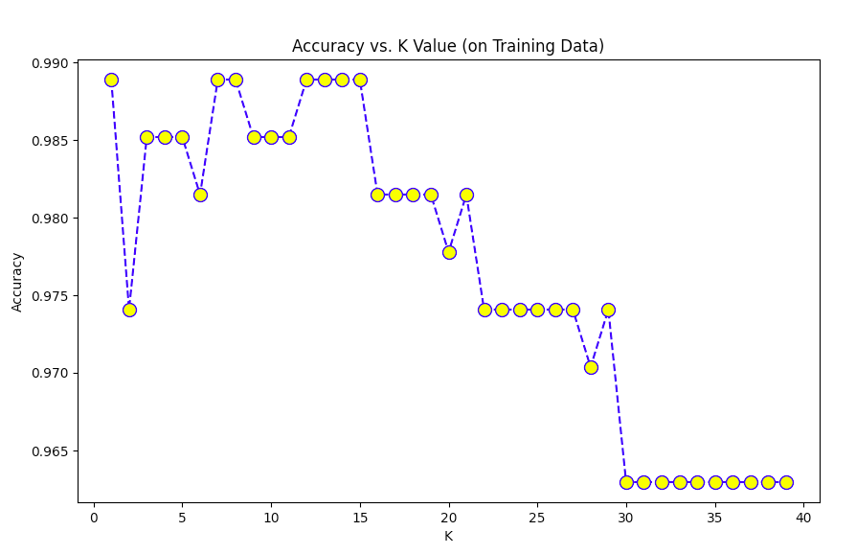
Methods
K-Nearest-Neighbor (KNN) Classifier
Silhouette Score calculation to find optimal K value (was 2)
Split training data (80:20) into ‘train’ and ‘test’ sets
Compute accuracy of model for different K values (1-40) [was 12]
Classify the 1505 planets test set
Approach – Evaluate Performance of various Machine Learning Classification Models fit on Training data and evaluated on Testing data
Labeled Habitable feature sets as 1 and non-Habitable as 0
Linear Regression – Linear Fit on plotted test data vs. corresponding results
Logistic Regression – More suitable for binary classification, models probability of planet being habitable/non-habitable
Naïve Bayes Classification – Probabilistic machine learning model based on Bayes Theorem
K-Nearest Neighbors Algorithm – Supervised machine learning algorithm and preferred classification algorithm
Random Forest Classification – Robust machine learning algorithm made up of a large number of small decision trees
Silhouette Score vs. K Values for values 1-20
Model Accuracy vs. K values for K-Nearest-Neighbor Algorithm

Slide 5
Methods [Contd.]
Initialize One-Class SVM model
Heavily imbalanced dataset (non-habitable >>> habitable) => Very High reported accuracy but poor model performance
  Labeled most planets as non-habitable for KNN Classifier and other selected methods
New Approach => One-Class SVM algorithm model^{[3]}
  Rectifies imbalance in training data
  Performs a 50:50 split on training data
  Fits the model to the majority class (non-habitable planets)
  Detects outliers (habitable planets) in the test set (other 50%) and labels them as -1
  Calculate f-score for SVM model
  Evaluate model on 1505 planets test set
More “realistic” results but lower accuracy
Define outlier detection model with chosen hyperparameter value
Perform 50:50 train-test-split on Exoplanet Archive training data
Detect outliers in test set and reassign values to -1
Compute f-score to determine model accuracy
Use model to evaluate Exoplanet Archive test data

Slide 6
Results
Classification Model | Accuracy | No. of identified Habitable Planets, No. of Unique Star Systems | Balanced training data
Logistic Regression | 98.52% | 30 12 | No
K-Nearest-Neighbors | 98.89% | 7 4 | No
Random Forest | 100% | 43 16 | No
Support-Vector Machine | 23.38% (f-score) | 244 128 | Yes
1505 exoplanets out of 26000+ in dataset were suitable for model evaluation
Selected 3/5 highest accuracy classifiers in original list
Original choice of Classifier was KNN Classifier
  7/1505 (0.5%) marked as habitable, 1498 non-habitable
  K2-3 d, Kepler-1652 b [x 3], Kepler-1653 b [x 2], PDS 70 b
Random Forest Classifier had highest accuracy (100%)
  43/1505 marked as habitable
SVM One-Class Classifier is best for data of this nature
  Low accuracy is a downside
  Accounts for imbalanced data
  Most effectively trained model of the set: 244/1505 marked habitable
Common Exoplanets across all Classifiers:
  K2-3 d
  Kepler-1652 b system
Table summarizing Classifier results
Artistic Depiction: Earth vs. Kepler 1652-b

Slide 7
Conclusions
The motive of this project has been achieved with respect to building a working classifier on the Exoplanet Archive data and testing various Machine Learning methods on it
The initially preferred classifier algorithm was KNN
The sparse dataset brings challenges leading to a smaller and imbalanced training dataset
The SVM One-Class Classification technique rectifies the imbalance and is more generous with its classification of habitable planets
This project can be useful in identifying potentially habitable worlds and in concentrating efforts in interplanetary travel, extraterrestrial outreach, and the search for life outside of Earth
Next Steps include Feature Engineering and exploration of Deep Learning Classifiers
Machine Learning is a powerful tool for analyzing large datasets
References
[1] https://exoplanetarchive.ipac.caltech.edu/
[2] https://github.com/rkmisra/cs229_project
[3] https://machinelearningmastery.com/one-class-classification-algorithms/
[4] doi:10.6062/jcis.2016.07.03.0112
[5] http://www.exoplanets.org/cps.html

Slide 8
Acknowledgements
I would like to thank the NASA Space Grant program and Arizona Space Grant Consortium for their support without which this project would not be possible
I would like to thank the ASU/NASA Space Grant Staff for their support, guidance and numerous opportunities
I would like to thank Professor Huan Liu at ASU for supporting this project in the Data Mining & Machine Learning (DMML) lab
I would like to thank my mentor Kaize Ding from the DMML for mentoring me throughout this project, answering all my questions, and helping me through the research process

Slide 9
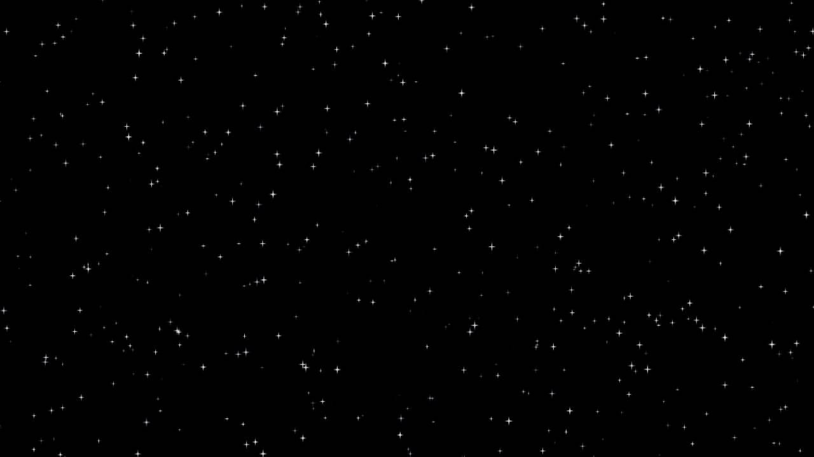
THANK YOU

